Slide 1
Let’s revise

Slide 2
What are HTML Entities?

Slide 3
What is the difference between <strong>, <b> tags and <em>, <i> tags?

Slide 4
What are the <thead>, <tbody>, and <tfoot> tags used for?

Slide 5
Is the <datalist> tag and <select> tag same?

Slide 6
No. The <datalist> tag and <select> tag are different. In the case of <select> tag a user will have to choose from a list of options, whereas <datalist> when used along with the <input> tag provides a suggestion that the user selects one of the options given or can enter some entirely different value.

Slide 7
What are Semantic Elements?

Slide 8
Semantic elements are those which describe the particular meaning to the browser and the developer. Elements like <form>, <table>, <article>, <figure>, etc., are semantic elements

Slide 9
How frames are different from rules attributes in HTML tables?

Slide 10
Write a HTML Code for creating table for the given situation.
The table has three columns: "Employee", "Position", and "Salary".
There should five rows, each representing an employee and their corresponding details.
The last row spans across columns using to display the total salary, and the value should be manually written as "9000"

Slide 11
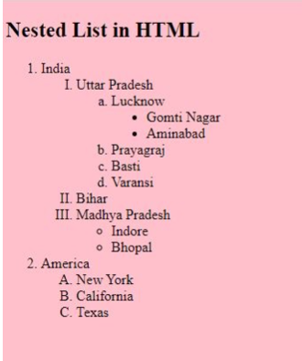
Write a code to implement this

